Slide 1
Making a Square root calculator: AT Math
By: Glenn Jones

Slide 2
Running entry 1
Downloaded Java
watched YouTube videos on how to read the code.
Problem 1: Need a reading platform → had to download BlueJ to read my code
After day one, I got Java to say “Hello world” after basic instructions.
This is what my code looked like:

Slide 3
Running Entry 2
-After practicing with a new language in code I decided to seek out more tutorials on different functions at this website → https://docs.oracle.com/javase/tutorial/
-I looked on this website and went through these stages to understand Java
At this point, I felt comfortable and familiar enough with the software and its functions.

Slide 4
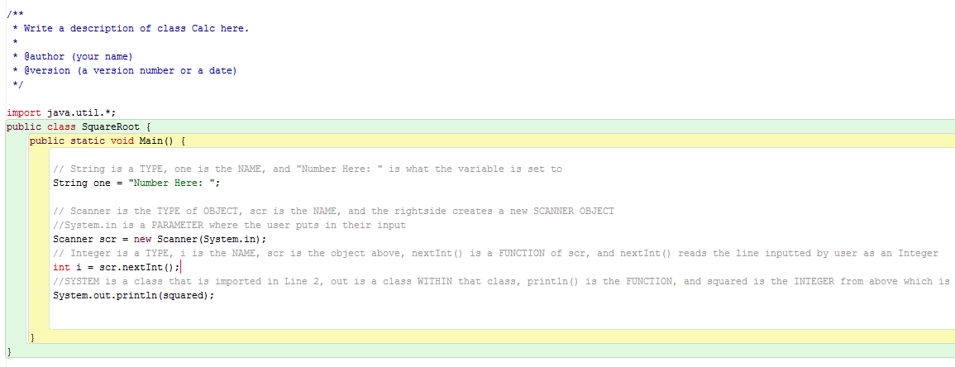
Running entry 3
I decided to begin a project to test my programming ability.
The Idea I settled on was to create a calculator that can square any number.
I began programing this mess and by the end of today, I have an incomplete project that looking like this

Slide 5
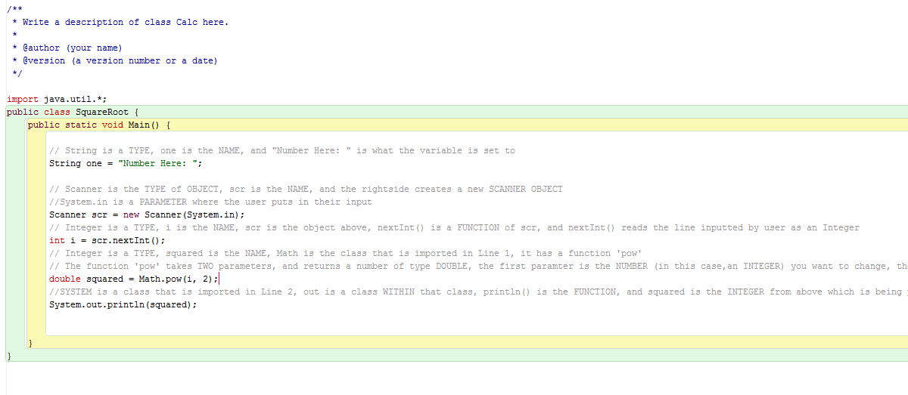
Running entry 4
I made a lot of progress today by looking at this website here: http://www.tutorialspoint.com/java/lang/math_pow.htm and finding the missinglink to get a number to become a squared number. I needed to create a code for “math.pow (i,2)” which translates to whatever the “i” integer is, square it to the 2nd power.

Slide 6
Running entry 5
I have been trying to find out why this program won’t run. It works, but only if I program it to square a specific number. For instance if I say “If the input is 2, then output is 4. I can’t figure out why I am not allowed to type any number.
I am going to try again in the morning. The best websites I found that may have an answer is:
https://docs.oracle.com/javase/8/docs/api/java/lang/Math.html
http://www.tutorialspoint.com/java/lang/math_pow.htm
https://msdn.microsoft.com/en-us/library/system.math.pow(v=vs.110).aspx

Slide 7
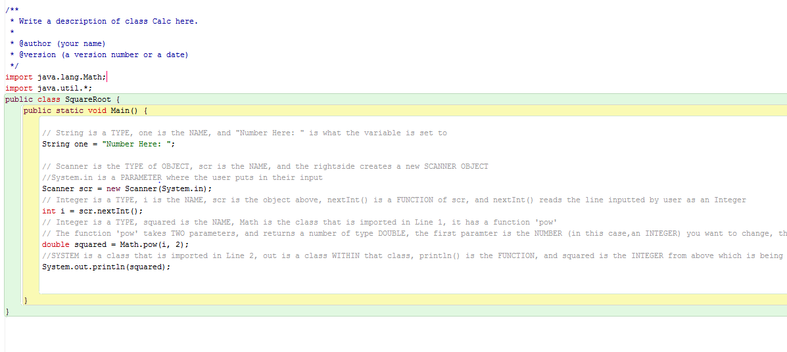
Running Entry 6
Problem Finally Solved! This took me forever to find. I was up until 2 am finding out what I could possibly be missing and THIS was the missing link. This is some algorithm that a mathematician created in the 70’s that has ALL square roots of a number. If I place this at the beginning, it taps into that database and retrieves the number I am requesting to square and gives me it’s squared form!
THIS

Slide 8
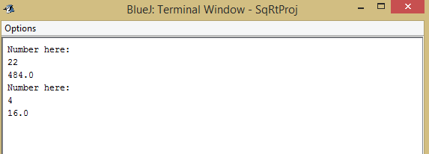
Running entry 6 cont…
-Once I discovered the problem after digging through websites for an answer the calculator was running beautifully. In the end, this is what it looked like. It would print “Number here:” And then you would type a number, it would read it, and spit out the square of that number.

Slide 9
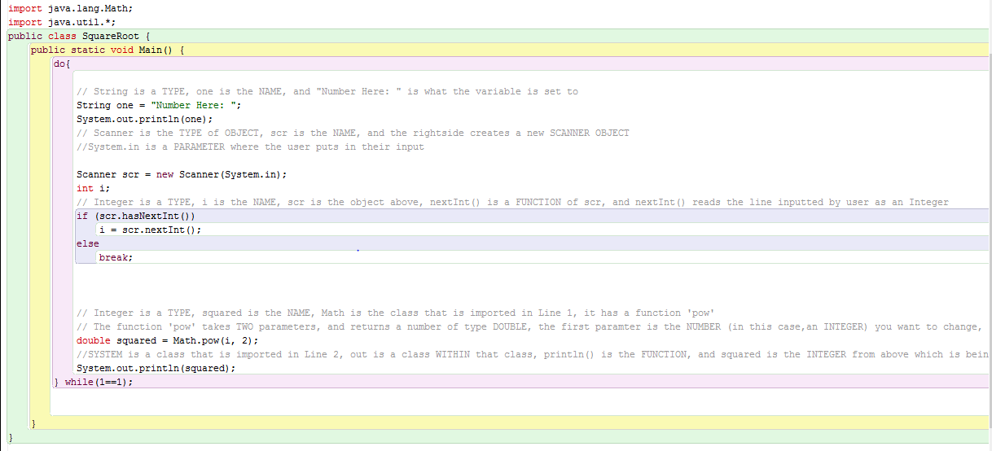
Running entry 7
I have now created a working square root calculator complete and able to run any numbers repeatedly over and over again. The code end result looks like this:

Slide 10
Running entry 7… Code explained
After a lot of research I have added these things highlighted in red. I was able to accomplish this work around 8-10:30 when I think I work most productively.
This is an important do-while statement that keeps it running on loop
This is an If-Else statement
This is comparing 1 to 1, meaning the system equals itself, therefore it keeps running the program if 1 continues to equal 1. If I type a different thing such as “end” then the program shuts off.

